Slide 1


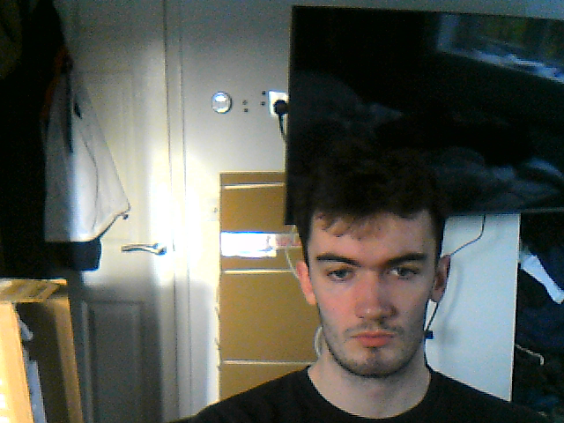

VR Meditation Game
Group 01

Slide 2
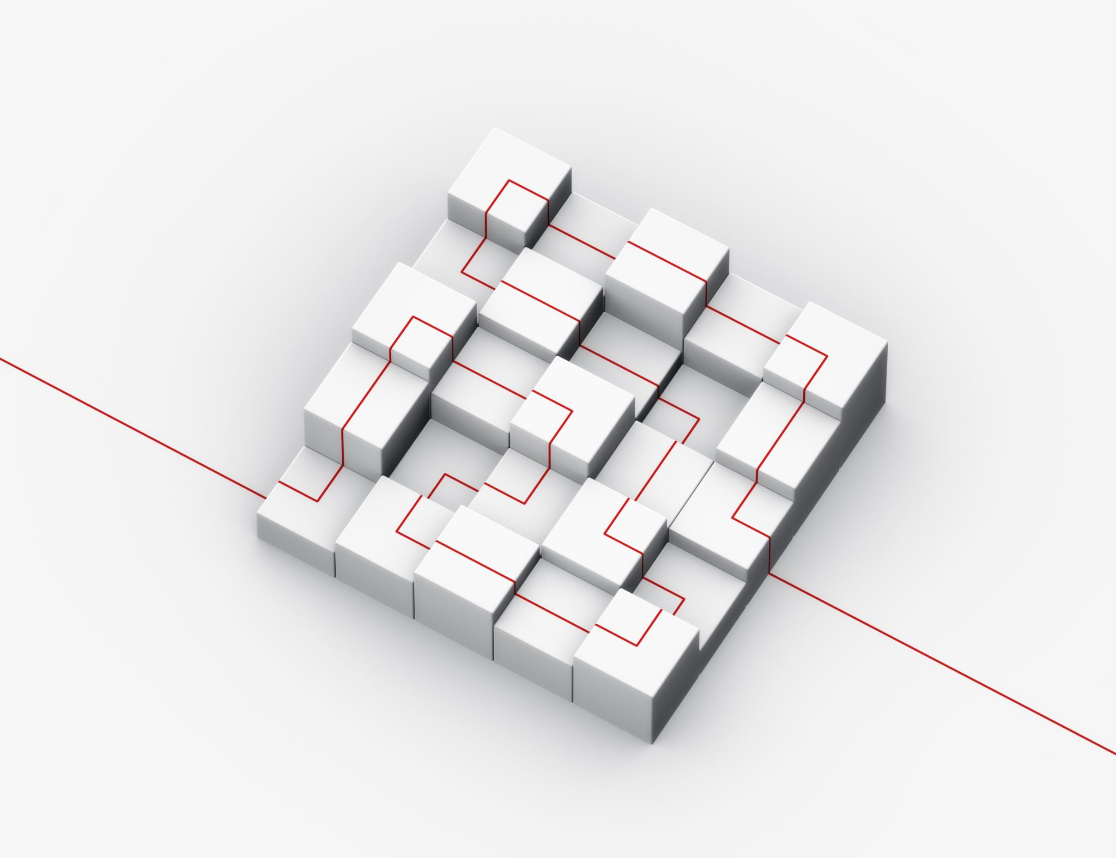
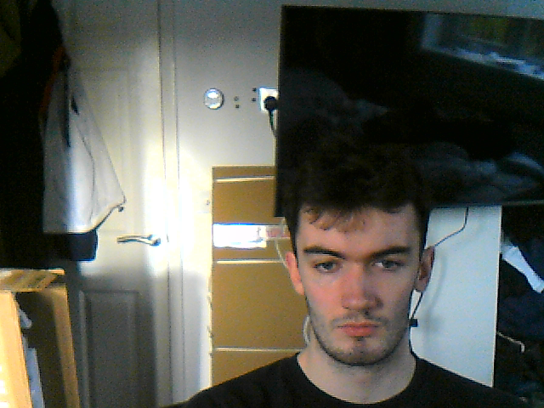

Presentation Structure
Introduction
Client
Aims
Important aspects
Deliverables
Technical outline
Hardware and setup
Meditation
Data Gathering
Future Plan
Project Plan
Timeline

Slide 3


1. Introduction
This section discusses the client, aims, important aspects and deliverables for the project

Slide 4

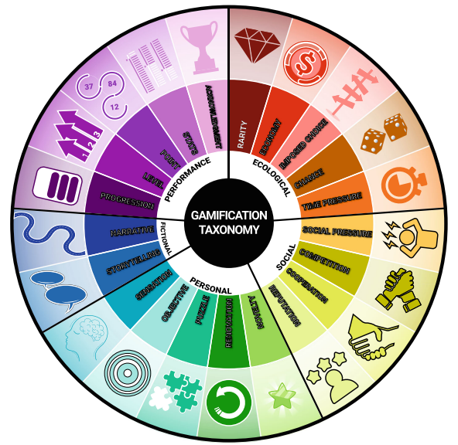

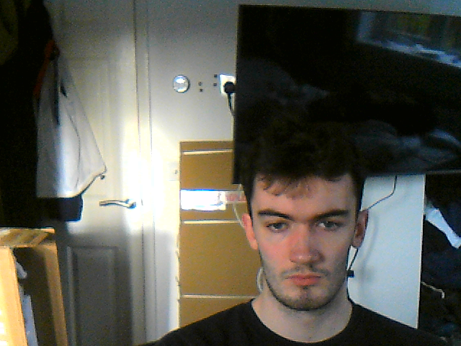
1.1 – Introduction of the client
Client Background:
Our client is a researcher from Durham University.
Her main area of interest is gamification taxonomy.
Notes:
Our main goals and aims for the project
Aims:
Groundwork:
Create a solid groundwork that can be used by the client in future.
Even if they decide they do not want to use the unity environments, the groundwork should be good enough to still use.
The underlying system should be reliable and easy to maintain and change for the client.
Ease of use:
Everything should be seamless and easy to run.
When we went for a meeting, the client was unable to demonstrate the existing software as it needed a phone and other accounts to run,
our ethos is that it should be able to be easy to set up and run, as a core requirement.
Data:
Should produce high quality data that is usable for research.
The software will be used for research, we want to make software so that the data already gathered is high quality and it is easy to add more metrics to be tracked,
even if the client does not use the environments, we create they should still be able to use the data gathering system.
Research:
Having read the clients research paper on gamification we have identified multiple elements we intend to implement in our project,
progression and point in the plant growth system
Objectives in the meditation to reach a certain growth level of the plant.
Sensation in the visual and audio guidance along with the VR

Slide 5



1.1 – Introduction of the client
Main aims for the project:
She wants the meditation app to be designed with a research focus.
She has communicated key features she wants included.
She has also told us some features she
wants us not to implement.
Notes:
Our main goals and aims for the project
Aims:
Groundwork:
Create a solid groundwork that can be used by the client in future.
Even if they decide they do not want to use the unity environments, the groundwork should be good enough to still use.
The underlying system should be reliable and easy to maintain and change for the client.
Ease of use:
Everything should be seamless and easy to run.
When we went for a meeting, the client was unable to demonstrate the existing software as it needed a phone and other accounts to run,
our ethos is that it should be able to be easy to set up and run, as a core requirement.
Data:
Should produce high quality data that is usable for research.
The software will be used for research, we want to make software so that the data already gathered is high quality and it is easy to add more metrics to be tracked,
even if the client does not use the environments, we create they should still be able to use the data gathering system.
Research:
Having read the clients research paper on gamification we have identified multiple elements we intend to implement in our project,
progression and point in the plant growth system
Objectives in the meditation to reach a certain growth level of the plant.
Sensation in the visual and audio guidance along with the VR

Slide 6
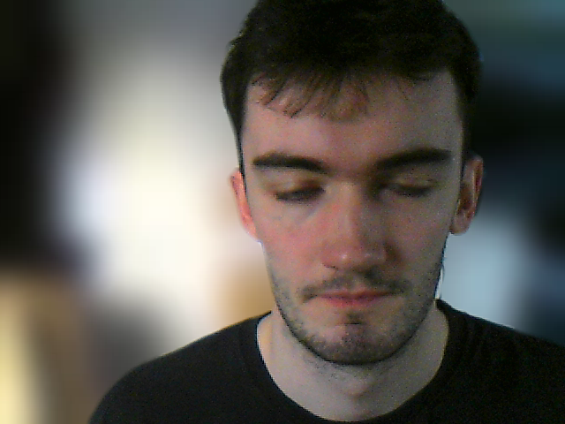





1.2 – Solution Overview
Meditation Environments
Plant Biometric Representation
Visual and Audio Guidance
Researcher Configuration
Data Gathering
Notes:
Our proposed solution to fulfil the clients requirements is a VR Meditation game:
It will have multiple meditation environments that the researcher can configure and select.
A plant growing in front of the user to give visual feedback on the quality of their mediation.
Visual and audio guidance to help the user to meditate well.
The ability for the researcher to configure the meditation parameters so that they can test the effectiveness of different parts of the software
A comprehensive data gathering system to gather and store research data

Slide 7
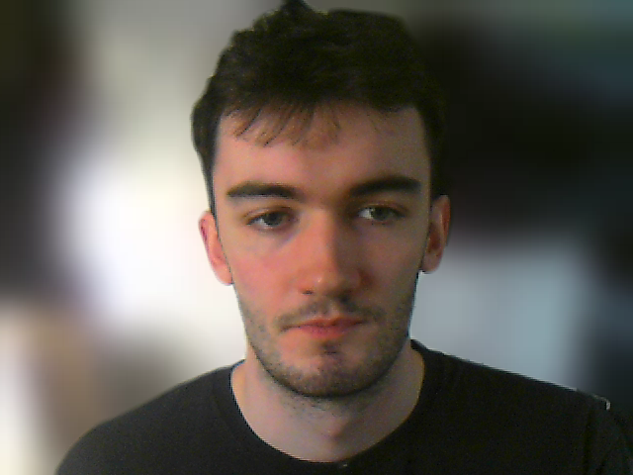
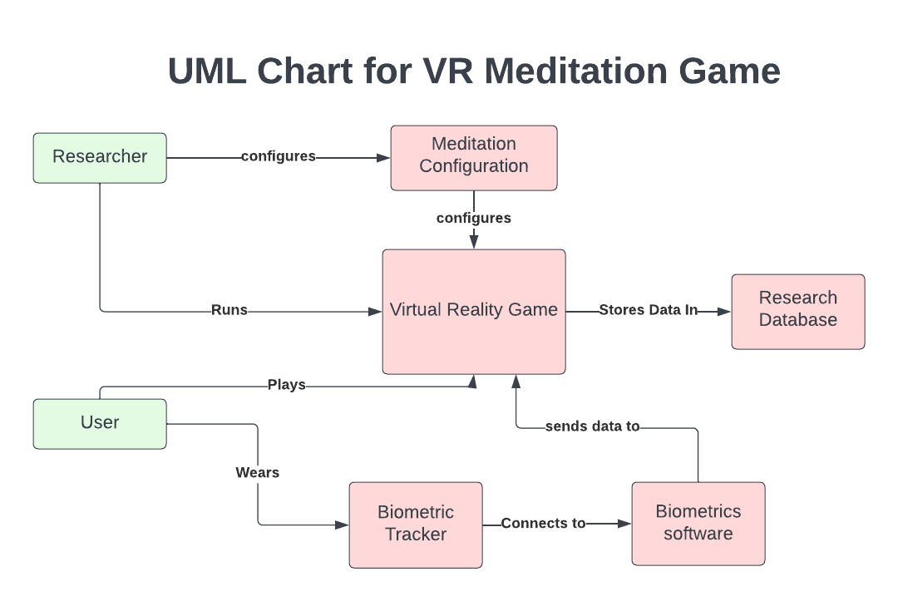
UML diagram
Notes:
Here is a proposed UML diagram for how the system will work with the researcher configuring the game and then running it for the student who is wearing a biometrics tracker which will send data to the game which will then change the flower to reflect the changes in relaxation and store data to a database.

Slide 8
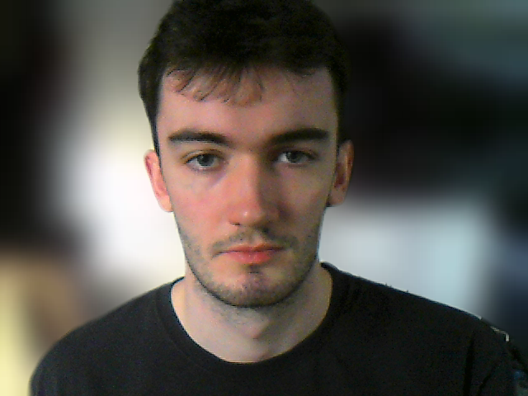
1.3 – Goals and aims
Main aims for the project:
Create a robust groundwork
Easily configurable and runnable software
Generate High quality meditation data.
Creatively apply the client’s research
Notes:
Our main goals and aims for the project
Groundwork:
We want to Create a reliable underlying system so that the software is robust and maintainable for the client
Ease of use:
We believe The software should be seamless, easy to run and require minimal setup or equipment
Data:
We would like to produce high quality data that is usable for research and follows GDPR and data gathering standards.
Research:
We will try to apply as many gamification elements from the client’s research as possible – we have outlined progression, point, objectives (plant growth) and sensation audio and vr

Slide 9
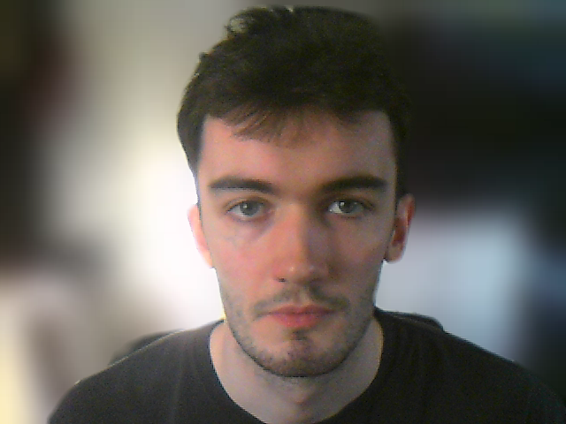






1.4 – Important Aspects
Essential Components
Tech stack
Security in data gathering
Compliance to standards
UX design
Collaboration with the client
Notes:
The aspects we feel will be important while developing the software are:
1. Essential Components for the software:
Biometrics system
Plant growth
Mediation environments
Researcher configuration
User telemetry
2. Tech Stack:
Fitbit API or openBCI for biometrics
Unity and blender for game development
GitHub for Version control and collaboration
4. One of the most important aspects will be security:
Making sure our software sticks to GDPR standards to avoid storing data that is identifying
As well as giving the user informed consent as to what data is stored and how its used.
5. There are many standards we will have to consider
The software will adhere to data storage standards,
Store standard metrics for meditation research,
industry standards for biometrics tracking,
Unity and oculus quest standards for the game.
3. UX Design will be important:
We want a clean user interface that is not overwhelming for the user to enhance the mediation experience.
6. Collaboration with Clients:
Regular email communication along with regular demonstrations of prototypes to make sure the project aligns with client expectations.

Slide 10
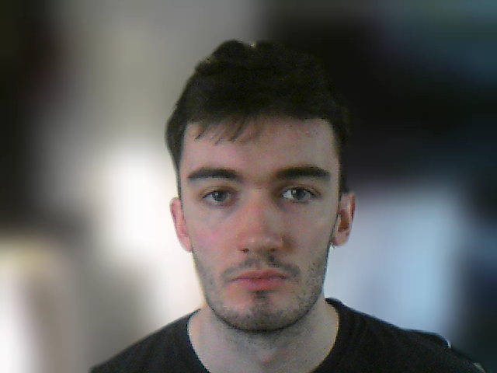
1.5 – Deliverables
Biometrics tracking system
VR meditation environments
Data gathering system
Test plan report
Code Documentation
User manual
Notes:
Biometrics tracking system
System to gather the biometrics data and send it to the computer
Meditation Environments
Multiple meditation environments for the game
Data Gathering system:
The data gathering system for tracking and storing data
Test plan
document outlining the strategy, scope, resources, schedule, and procedures for testing a software application
Code documentation
set of documents that provide a detailed explanation of the source code of the software#
User Manual
document designed to guide end-users on how to effectively and efficiently use the system
I wil now hand over to Pad for the technical outline section

Slide 11
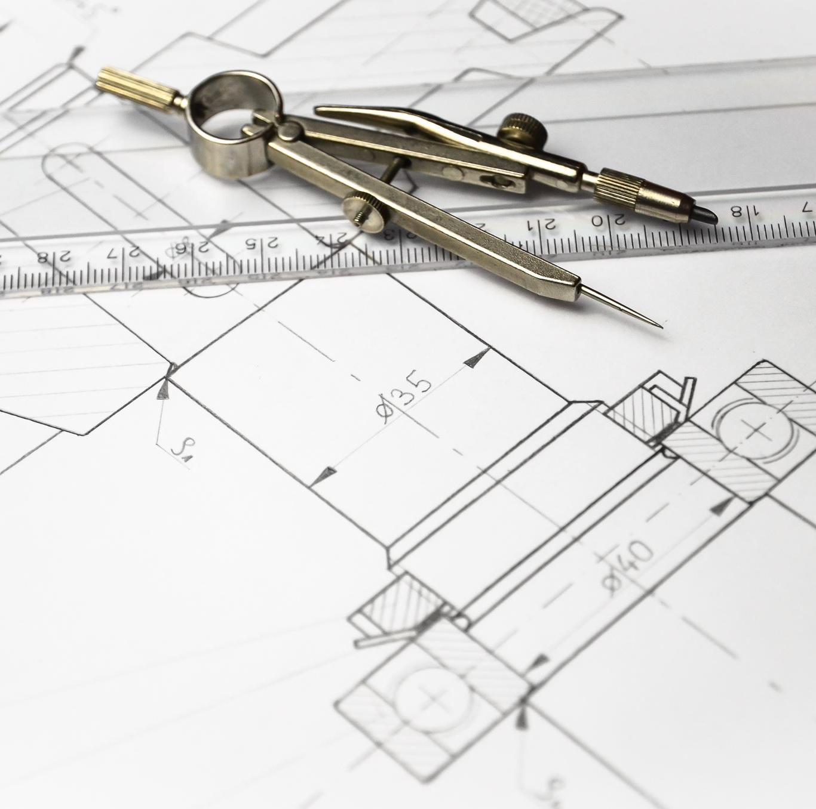
2. Technical Outline
This section discusses the proposed technical solution and implementation for the project

Slide 12
Proposed Solution
Hardware and setup
Meditation
Data Gathering

Slide 13
Hardware
Hardware and setup
Oculus Quest 2
Biometric Tracking Hardware
PC capable of running VR Environment
Meditation
Data Gathering

Slide 14
Current Start-up Process
New Start-up Process
Researcher connects Fitbit to Android Phone
Researcher starts main process
Researcher starts Unity Project
< 30 Seconds
User manually selects desired VR Scenery
VR Environment fully ready to use for user
VR Environment ready to use for user

Slide 15


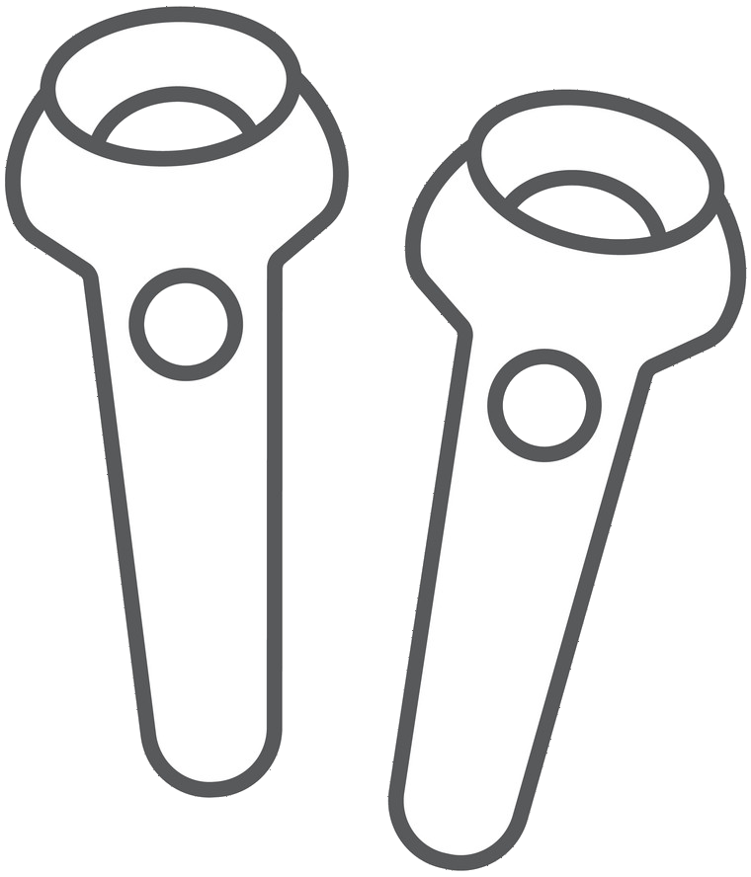
2.2 - Meditation
User responsive elements:
Heart rate adaptive plant growth
Visual meditation guidance
Player movement

Slide 16
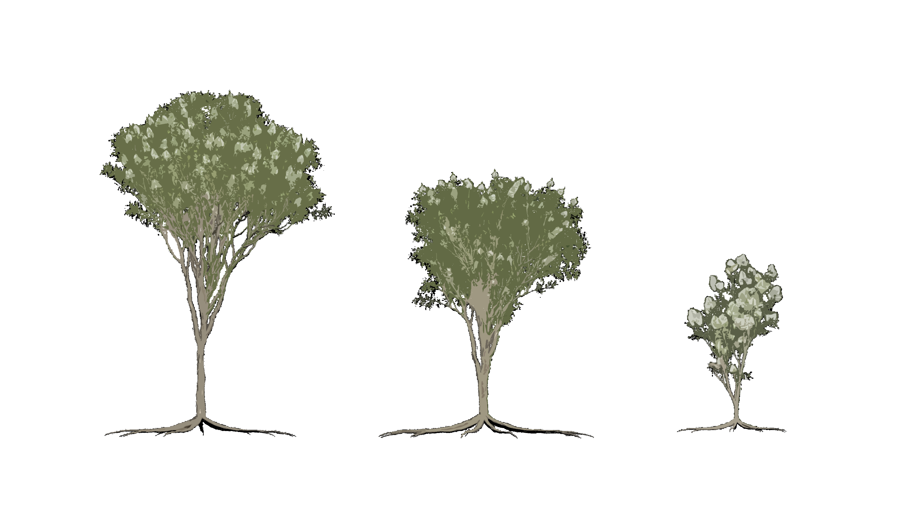
Heart rate adaptive plant growth
The plant will grow based on how well the session is going.

Slide 17
2.2 - Meditation
User responsive elements:
Heart rate adaptive plant growth
Visual meditation guidance
Player movement

Slide 18

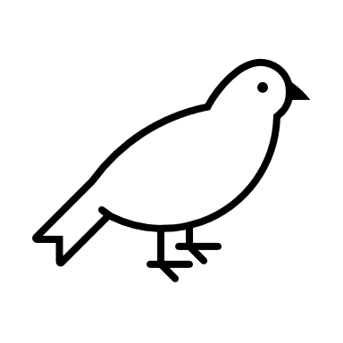

2.2 - Meditation
Passive elements:
Calming environments
Calming sound affects
Calming Music

Slide 19
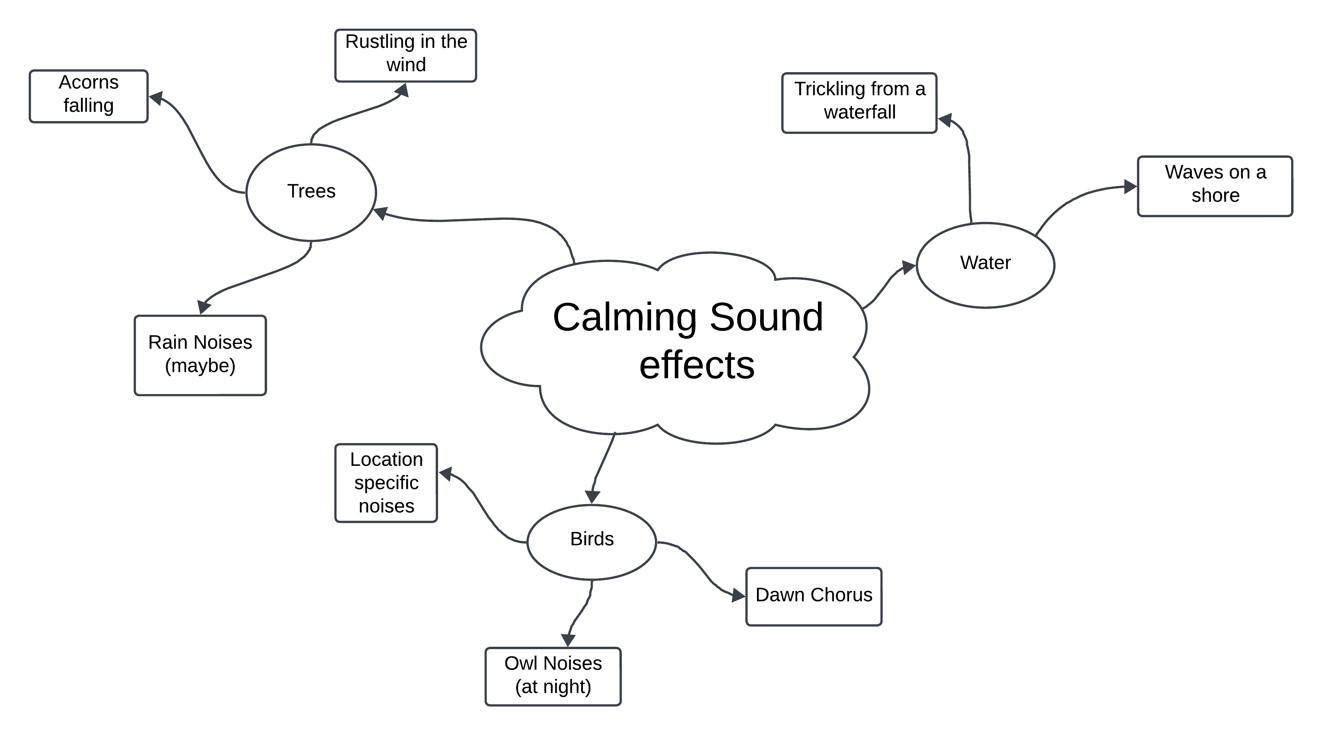

Slide 20
2.2 - Meditation
Passive elements:
Calming environments
Calming sound affects
Calming Music

Slide 21

2.3 – Data Gathering
Important Aspects of Data Collection
Store data in an appropriate format

Slide 22
2.3 – Data Gathering
Prototype Object Data Structure
Sessions
Environment | String
Length of Session | Int
Parameters | Object [Parameters]
Demographics | List
Primary Metric | List
Secondary Metric | List
Parameters
Light Level | Int
Volume | Int
Location | String
Time of Day | Boolean

Slide 23
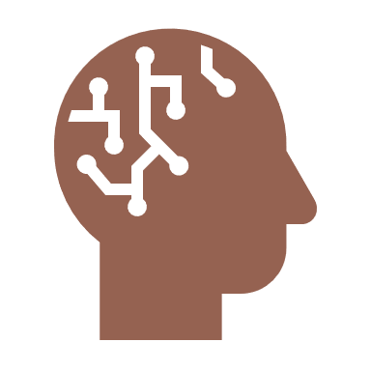
2.3 – Data Gathering
Important Aspects of Data Collection
Store data in an appropriate format
Data easily accessible for use in research
Record metrics for research purposes

Slide 24
2.3 – Data Gathering
Graphical Usage of Collected Data

Slide 25

2.3 – Data Gathering
Important Aspects of Data Collection
Store data in an appropriate format
Data easily accessible for use in research
Record metrics for research purposes
Store data in compliance with GDPR

Slide 26


3. Future Work

Slide 27
3.1 - Project Plan
Aspects of system to be developed
Hardware and Setup
Meditation
Data Gathering
Notes:
In our first technical development sprint, our goal is to have three systems up and running: Hardware,
Meditation,
and Data Gathering.
Our aim is to set up and integrate all necessary hardware with Meditate VR. Once set up, users will be able to enter a meditation session and follow a VR-based meditation plan while their heart rate is logged in real-time. We plan to implement and test these systems by the end of our first technical development sprint, meeting the minimum viable product requirements specified by the client

Slide 28
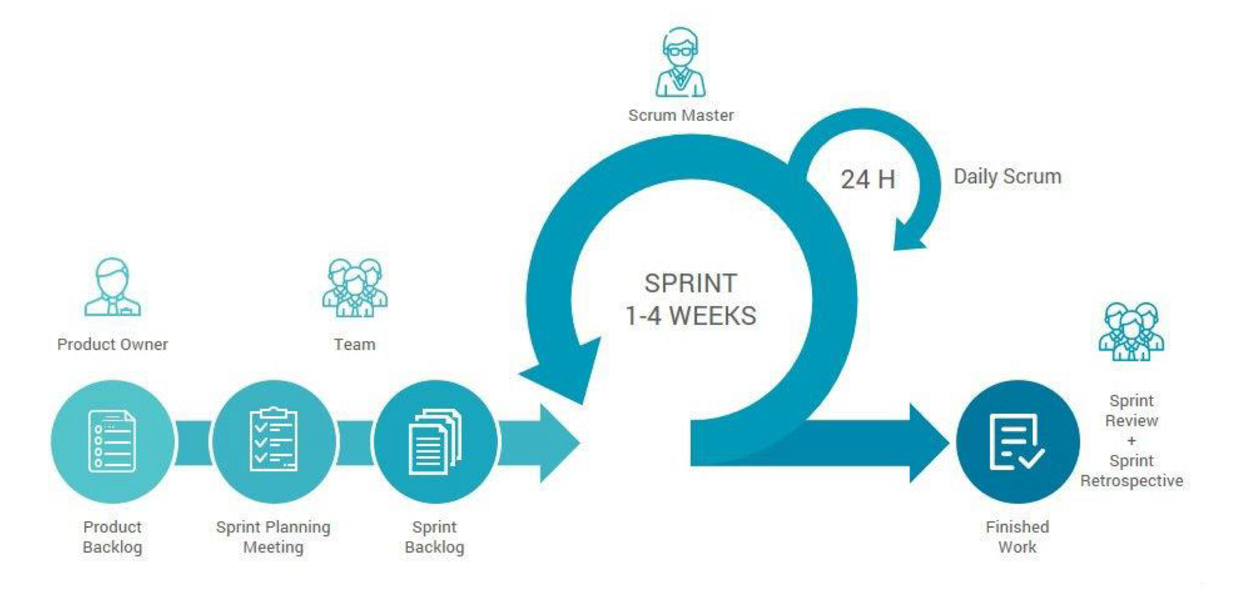
3.1 - Project Plan
SCRUM Development Methodology
Software Engineering: SD Methodologies III - SCRUM Methodology
Notes:
Throughout this project, we will be using the SCRUM methodology to ensure we meet our client's needs and stay adaptable to changing requirements and challenges that arise as we carry out sprints to develop Meditate VR.

Slide 29
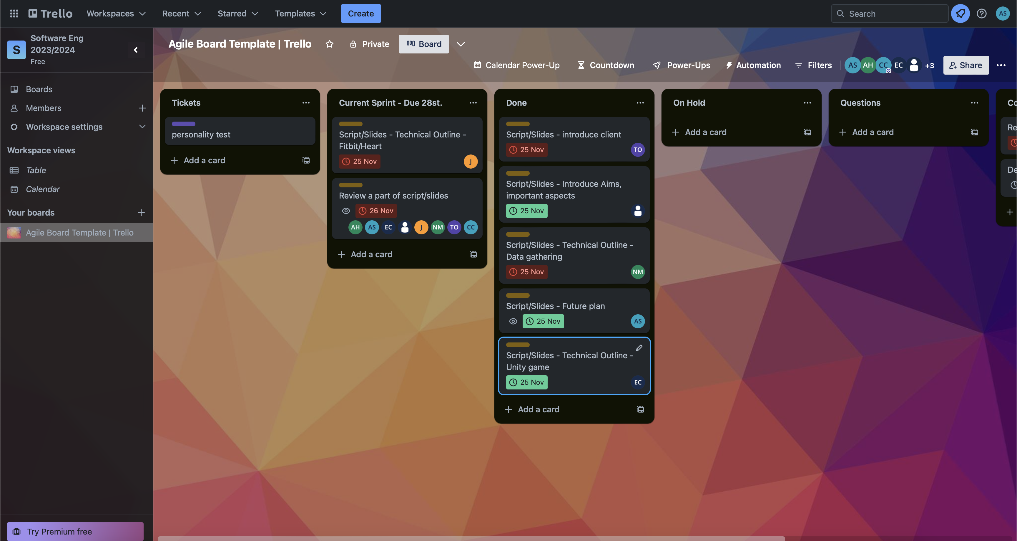
3.1 – Project Plan
Trello
Notes:
We are also using Trello to assist us in assigning tasks and ensuring that they are completed efficiently.

Slide 30
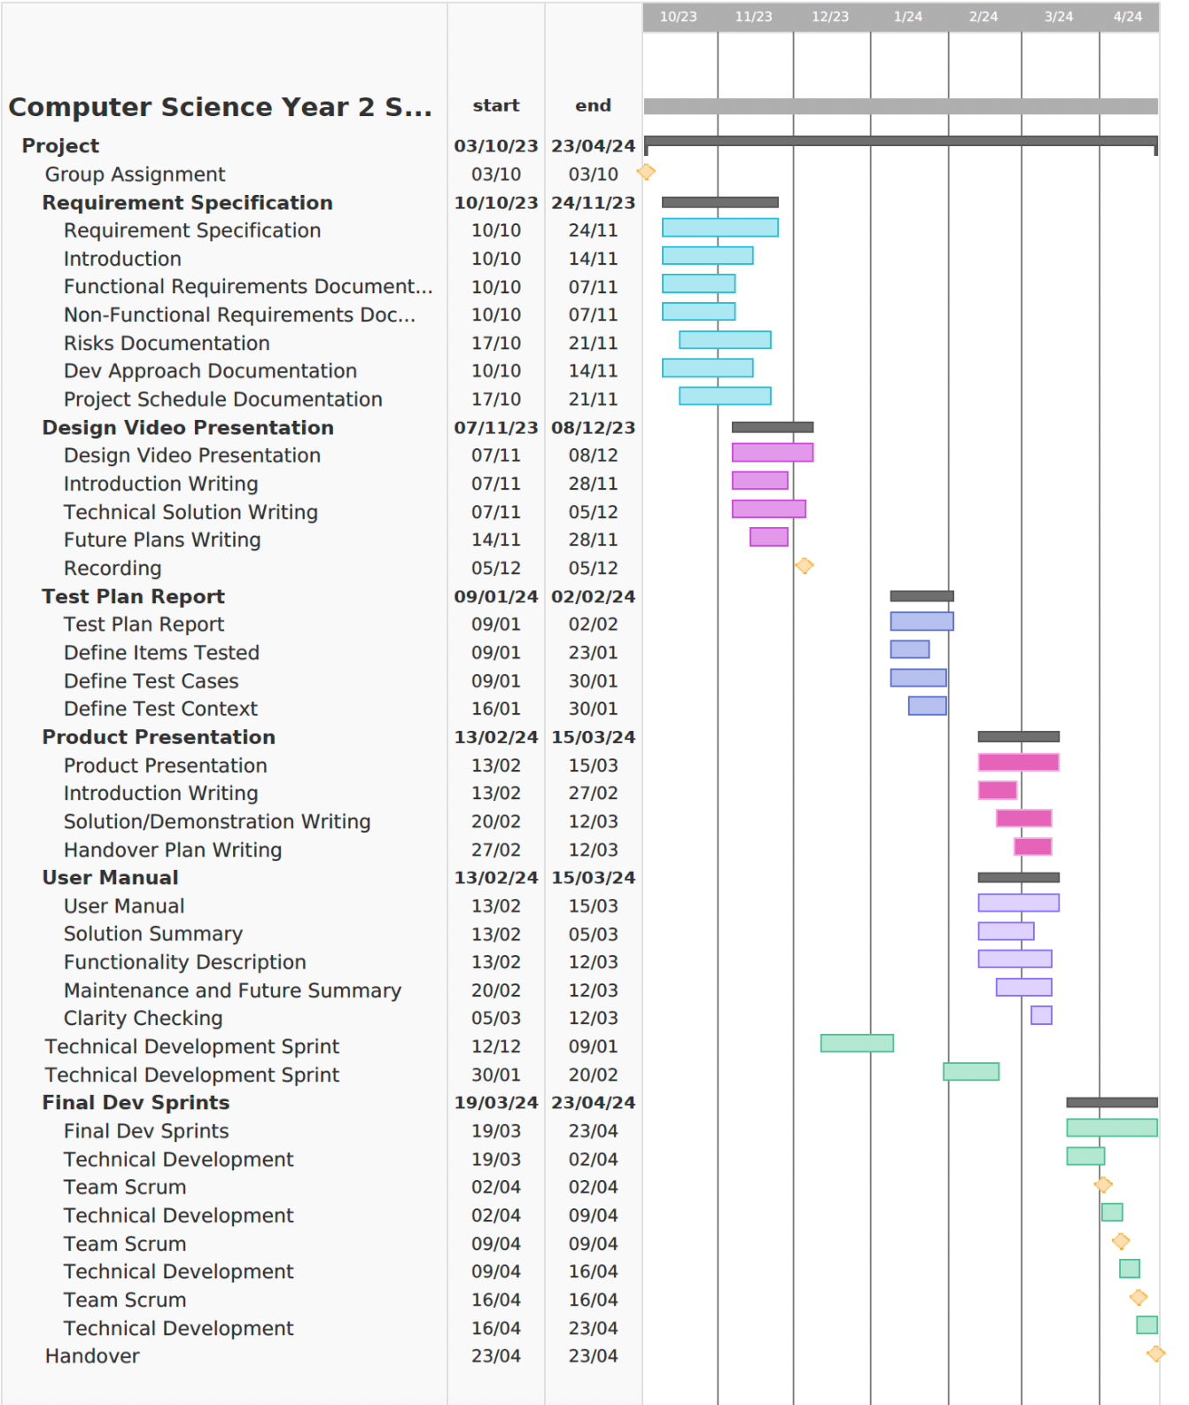
3.2 - Timeline
Gannt Chart
Notes:
Our project will be developed according to the timeline outlined in our Gantt chart which consists of six stages. By the end of the first technical development, we will have implemented the key aspects of our system

